Slide 1
Neo4J – The Graph DB
The natural way to persist data
Brijraj Singh
Sr. Tech. Evangelist (OSS)
@brijrajsingh

Slide 2
How to use this template:
Type
• Use only the Microsoft brand typeface for screen-viewed media—Segoe UI and Segoe UI bold.
• The Segoe UI typeface is available for download at Media Bank.
Layout
• Format your slides using the premade “Slide Layouts” of the presentation theme in this template.
• Use the slides with colored backgrounds for presentations in dark rooms.
• Instead of typesetting every word, use the “Notes” feature to reduce the amount of copy on your slides.
Resources
• Additional templates and photo assets can be retrieved from the Media Bank (Internal to Microsoft)

Slide 3
Agenda
Graphs !
Representing Data as Graphs
Modelling With Graphs
Neo4j Installation – Local + Azure
Preview – Neo4j Interfaces
Loading Data in Neo 4j
Cypher – The Query Lingo
Neo4j Language Plugins
Case Studies
Demo – Lets Play
Q & A

Slide 4
Are these Graphs ?
Notes:
Take a good look, and tell me are these graphs! No they are just charts, graphs are

Slide 5
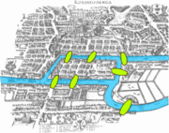
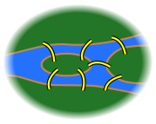
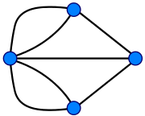
Image Courtesy - Wikipedia
Notes:
Euler lived in Königsberg for a while, and in 1736 he created and solved the problem known as the “7 Bridges of Königsberg”. The problem is to decide whether it is possible to follow a path that crosses each bridge exactly once and return to the starting point. This problem was the first study of graph theory.
Königsberg was divided into multiple areas by the Pregel river, and the 7 bridges (animation forward) joined the different city areas together. Euler first identified these 4 land masses (animation forward) and pointed out that the choice of route inside each of the 4 city areas was irrelevant to the problem.

Slide 6
Data on Graphs
Ram
Brother Of
Laxman
Brother Of
Husband Of
Wife Of
Sister In Law
Seeta
Notes:
Relationships or the edges – are quite natural by representation in graphs rather than conventional RDBMS’s
Both Relationships and Relation holding entities or nodes are Objects, and both may have properties as well, for now in this graph the properties are quite obvious, Nodes have names, and Edges have relationships between these divine characters.

Slide 7
Data on Graphs
Brother Of
Since : Birth
Name : Ram
Gender : Male
Name : Laxman
Gender: Male
Brother Of
Since: Birth
Husband Of
Since: 15yrs
Wife Of
Since: 15 yrs
Sister In Law
Since : 15 yrs
Name : Seeta
Gender: Female
Notes:
The Relationships may also hold their own properties, This is the Property Graph Model, which has the following characteristics:It contains Nodes and Relationships, both of which can contain properties (key-value pairs).Relationships are always between exactly 2 nodes. They have a type, and they are directed.

Slide 8
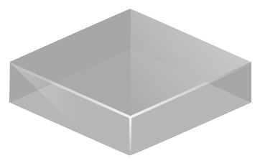



397
Dr. Sharma
327
Robin
397
327
411
327
397
999
999
Neetu
411
Dr. Verma
Doctor
Doctor_Patients
Patient
Image Courtesy – Neo4J
Notes:
We have a doctor Dr. Sharma, and a Dr. Verma
Doctor Sharma – looks out for both Robin and Neetu, while Dr. Verma looks out for Robin only as a patient, as you can see in the doctor_patients we are just keeping the relations with the help of ids and may be even the relationship has an id over here; lets look at the same relationship with the help of graphs,

Slide 9
397
Dr. Sharma
Doctor_of
327
Robin
Doctor_of
Doctor_of
999
Neetu
411
Dr. Verma
Image Courtesy – Neo4J

Slide 10

Modelling your Data
The Graph way

Slide 11
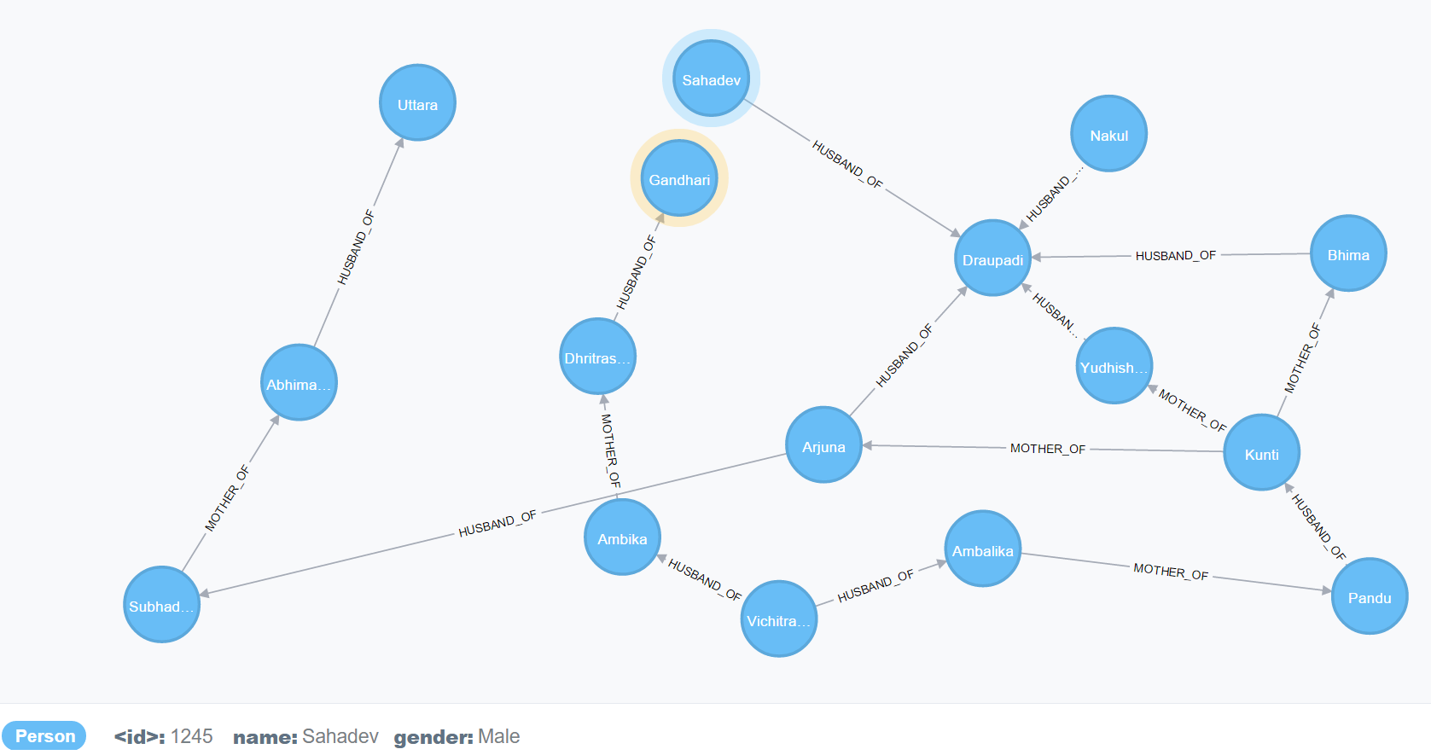
Notes:
Start modelling your graphs with nodes, see what properties do they have, like here the blue aura selected one is “Sahadev” a Male character from Mahabharat, the properties he may have are id, name and Gender and may the kind of fighting skill he possessed.
And then start drawing the relationships from whom to whom, a lot of times relationships could be 2 way, like in this case ditch the “husband and wife” relations and rather call it “Spouse Of” . The representation that you’d draw over a piece of paper will show up same in a graph database.

Slide 12

Neo4J Installation – Local Machine
Get it from neo4j.org or Github https://github.com/neo4j
2 kinds of Packages
Enterprise Edition
Community Edition
Download and Install at
Windows
Linux Variants
Mac OS X

Slide 13
Neo4J Installation – Local Machine
bin\neo4j start
Runs at http://localhost:7474
Configurations are available at conf/neo4j-server.properties (Linux and OSX), <Roaming Path>\neo4j-community\neo4j-server.properties (Windows)
Need Open JDK or Oracle Java – choose either
Notes:
Next slide – see Neo4j Monitoring with command, while the enterprise users will get a separate dashboard for monitoring

Slide 14
Neo4J Installation – Azure - Demo
Find the Latest Neo4J VM Image from VM Depot
Copy to your Storage Account
Register your Image
Create a VM from the Image
Remember ! To open the 7474 port

Slide 15

Neo4J – Azure
Neo4J Azure Managed Hosting Also available by GrapheneDB
http://www.graphenedb.com/pricing-azure

Slide 16
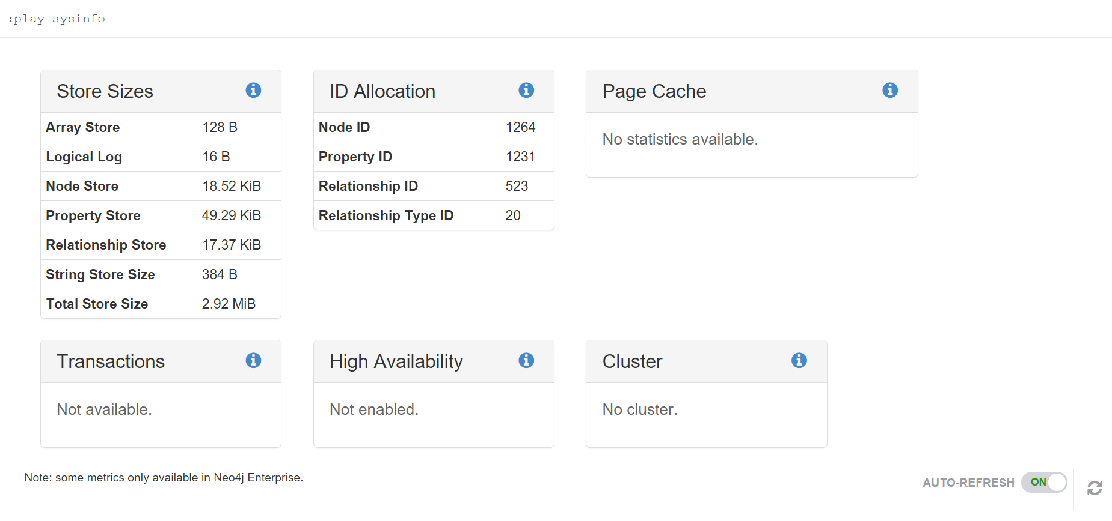
Neo4J Monitoring

Slide 17
Neo4J Developer Interfaces
REST API
.Net
Java
Spring Frameworks
Javascript
Python
Ruby
PHP
R, GO, Closure, Perl, Haskell
Notes:
Neo4j SDK are available for all these languages and as well as with Rest API – one can POST the queries directly and get the response.

Slide 18
Loading data in Neo4j
Convert your data to CSV and Load
Even Load Large Amounts of Data from BIG CSV Files using the Periodic Commit
Write your own load using Cypher Query and run the “Insert Queries”
LOAD CSV FROM 'http://neo4j.com/docs/2.2.6/csv/artists-fieldterminator.csv' AS line FIELDTERMINATOR ';' CREATE (:Artist { name: line[1], year: toInt(line[2])})
USING PERIODIC COMMIT 500 LOAD CSV FROM 'http://neo4j.com/docs/2.2.6/csv/artists.csv' AS line CREATE (:Artist { name: line[1], year: toInt(line[2])})

Slide 19
Cypher – The Graph Lingo
Designed for Graphs
SQL – Like syntax
Declarative Pattern Matching syntax

Slide 20
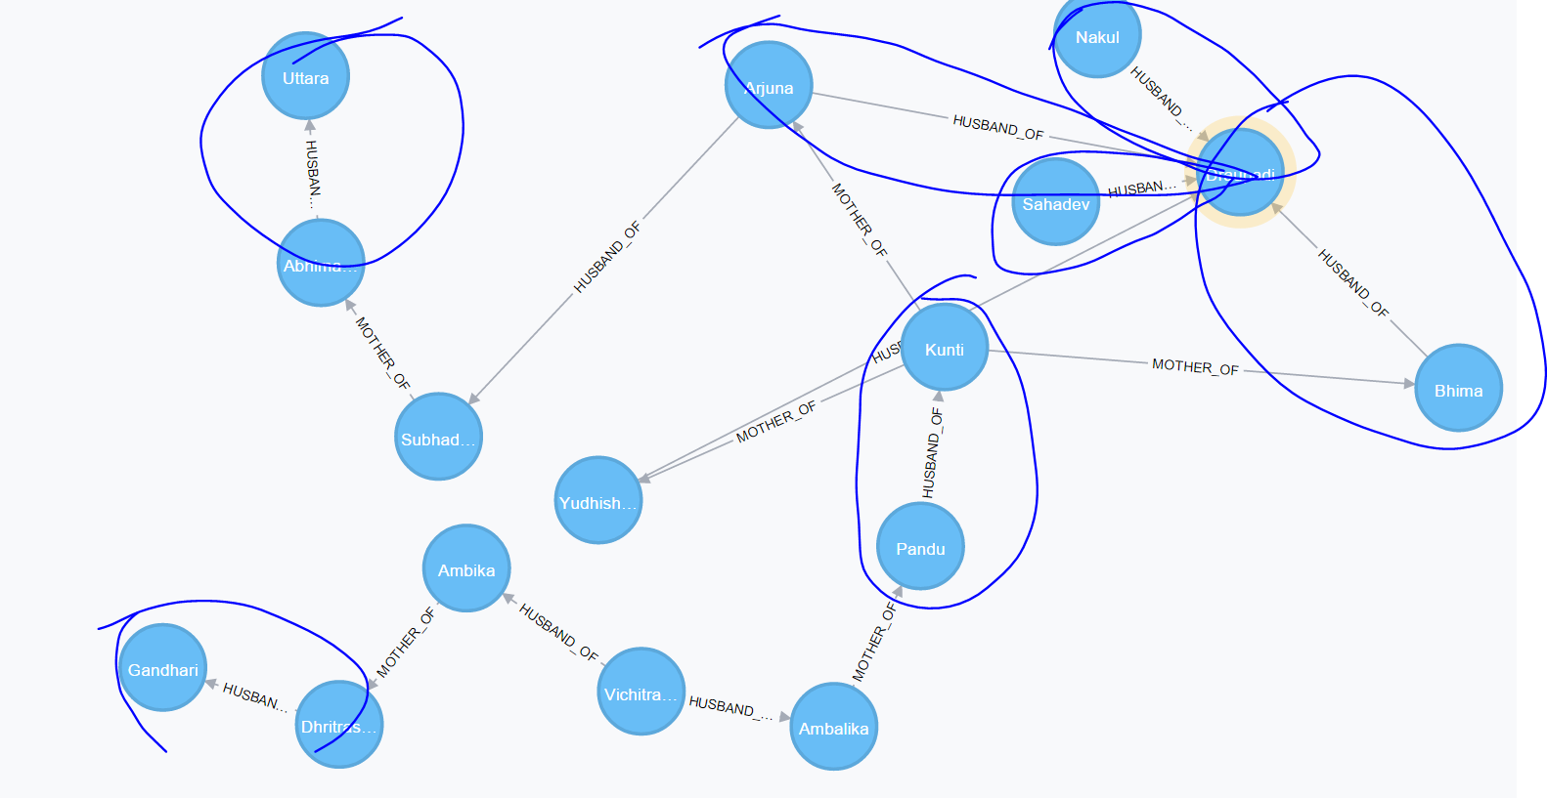
Cypher – The Graph Lingo
Notes:
Its all about the Patterns when it comes to graph databases, for ex see the patterns of “Nodes having “Husband_of” relations, Am I Missing marking some relations here?

Slide 21
Cypher – The Graph Lingo
MATCH a-[:HUSBAND_OF]->b Return a,b
Returns both Husband and Wife
MATCH a-[:HUSBAND_OF]->b Return a
Returns Just the ?
MATCH a-[:HUSBAND_OF]->b Return b
Returns Just the ?
Notes:
What are we doing here, We are matching a type of node a with relation to node b having a relation of “Husband_Of” and returning both the kind of nodes

Slide 22
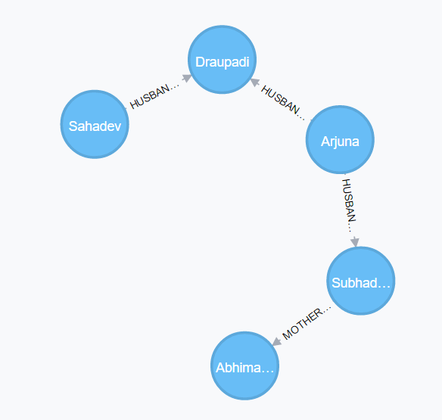
Cypher – The Shortest Paths
MATCH (sahadev:Person { name:"Sahadev" }),(abhi:Person { name:"Abhimanyu" }),
p = shortestPath((sahadev)-[*]-(abhi))
RETURN p
Notes:
Finding the Shortest Paths between sahadev and Abhi manyu, if be given a relational db , think about how much lines of code would need to be written

Slide 23



Case Studies
Bollywood ki kasam
A game based over Bollywood Movies and Stars.
Find the shortest Path between 2 Actors
Backend Hosted at Azure
eBay
eCommerce Delivery service routing with Neo4J
Wanderu
Book Travel using Shortest and optimal Paths with Mix of
travel options

Slide 24
DEMO !
Lets Play a game of Shortest Paths

Slide 25
Q & A

Slide 26


References
http://neo4j.com
https://github.com/neo4j/neo4j
http://neo4j.com/developer/language-guides/
http://neo4j.com/docs/stable/ha-architecture.html
https://github.com/neo4j-contrib/graphgist/wiki
http://graphenedb.com
technet.microsoft.com/en-in
aka.ms/mva
msdn.microsoft.com/
Developer Network

Slide 27

Tell us what you think
Help us shape future events by sharing your valuable feedback.
Scan the QR code to evaluate this session.

Slide 28

Thank you
Follow us online
Twitter: @brijrajsingh
Email: brsingh@Microsoft.com

Slide 29

Attend the last session of the day and
get a chance to
Win a Cool Device!

Slide 30

Tweet2Win Contest
Keep tweeting with #FutureUnleashed
&
Win exciting prizes at the end of the day

Slide 31
Ask the Experts
Tweet a selfie with your question written on paper with #FutureUnleashed
&
Experts answer it for you @Meet the Experts session!

Slide 32






Download India Tech Community App now !!!

Slide 33

Continue Your Learning
@
www.microsoftvirtualacademy.com

Slide 34


Follow us online
Microsoft Developer

